Slide 1

Customer Personality Analysis …..
Mahesh Mangali

Slide 2

Project Overview:
To segment customers based on their demographics, purchasing behavior, and engagement patterns in order to enable targeted marketing and optimize business decisions..

Slide 3
Agenda
Data Collection
EDA and Data Preprocessing
Feature Engineering
Model Building & Evaluation
Deployment
Presentation Title

Slide 4
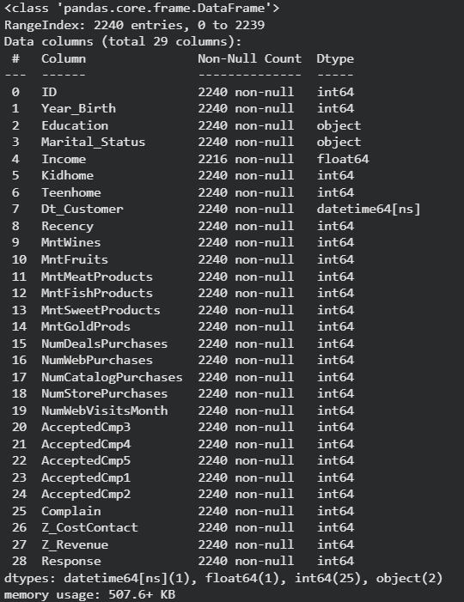
Dataset Overview:
Dataset Source : Marketing Campaign Dataset
Key Columns:
Customer Demographics
Year_Birth
Education
Marital_Status
Income
Household Information
Kidhome
Teenhome
Customer Behavior
Recency
Spending on products (Wines, Fruits, Meat, Fish, Sweets, Gold)
Purchase Channels
Web Purchases
Catalog Purchases
Store Purchases
Web Visits per Month
Campaign Interaction
Accepted Campaigns (Cmp1–Cmp5)
Response
Complaints

Slide 5
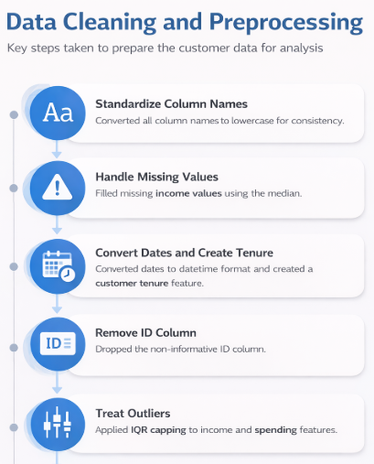
Data Cleaning & Preprocessing
Steps Applied
Standardized column names to lowercase
Imputed missing income values using median
Converted dates and created customer tenure feature
Removed non-informative ID column
Treated outliers using IQR capping on income and spending data
Stock Price Forecasting Using Time Series

Slide 6
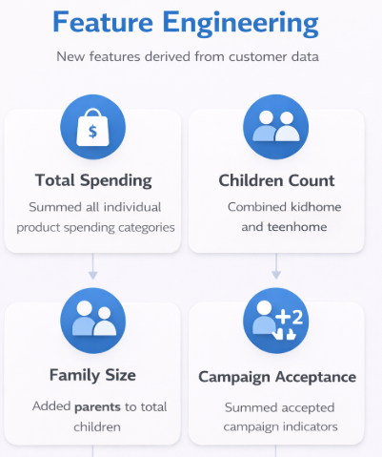
Feature Engineering
Created total_spending by aggregating all product expenditures
Derived total_children from kidhome and teenhome
Calculated family_size by including parents
Generated total_accepted_campaigns from campaign responses
Customer Personality Analysis

Slide 7
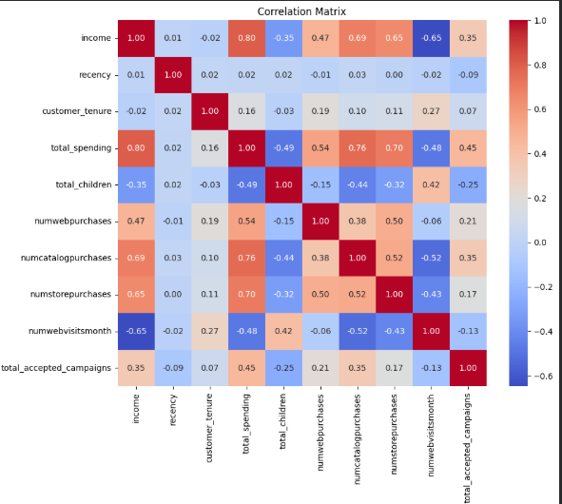
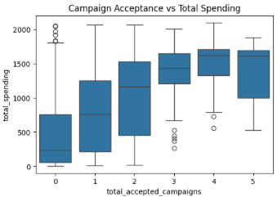
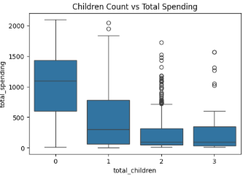
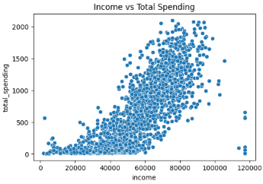
Exploration Data Analysis :
Analyzed distributions of key numerical features using histograms and skewness
Examined relationships using scatter plots and box plots
Identified linear relationships through a correlation heatmap

Slide 8
Model Building :
Feature Scaling: Applied StandardScaler to normalize all selected features (mean = 0, standard deviation = 1), ensuring equal contribution of features in distance-based clustering.
Hierarchical Clustering
DBSCAN Clustering
K-Means Clustering
Generated a dendrogram using Ward linkage to validate cluster count and trained an Agglomerative Clustering model with 3 clusters.
Tuned parameters using a K-distance graph, set eps = 1.2 and min_samples = 20, and trained a DBSCAN model to identify dense clusters and noise points.
Used the Elbow Method (WCSS) to determine the optimal number of clusters and trained a K-Means model with k = 3 on the scaled data.

Slide 9
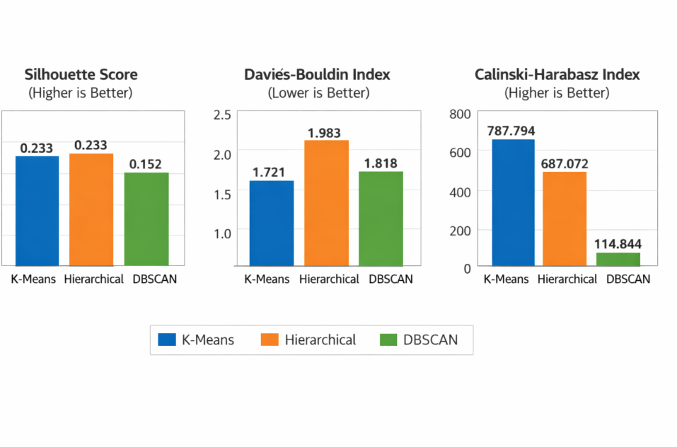
Model Performances :

Slide 10
Hyperparameter Tuning (K-Means)
Tuned Parameters for K-Means:
n_clusters: 2 to 5
init: random, k-means++
max_iter: varied values
n_init: multiple initializations to ensure stability

Slide 11
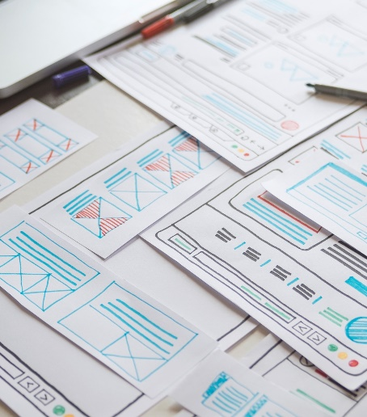
Deployment :
Deployed the customer segmentation model using Streamlit to provide an interactive prediction interface.
Implemented a Flask API to handle backend model inference programmatically.
Integrated the saved StandardScaler and K-Means model into both applications for consistent predictions.
Exposed the application publicly using ngrok for live access and demonstrations.
Customer Personality Analysis

Slide 12
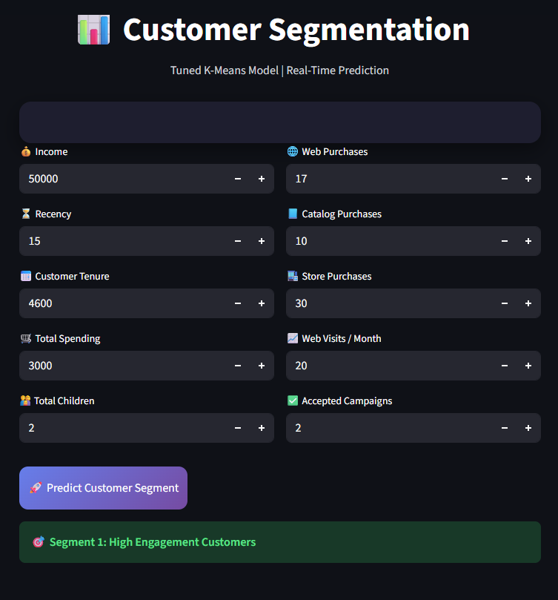
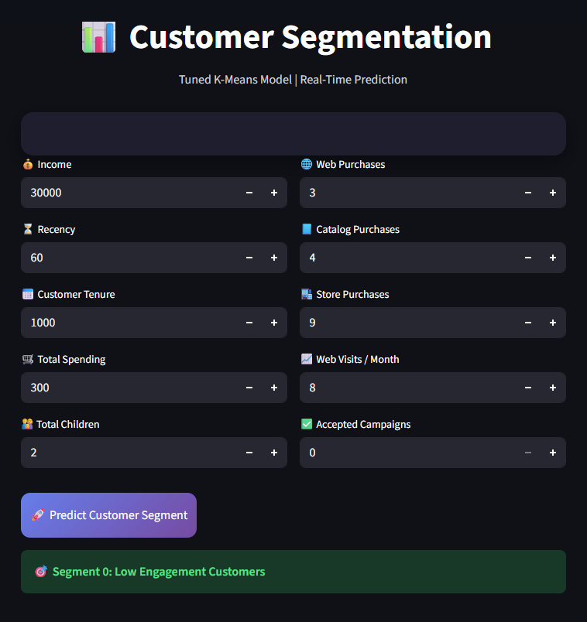
Final Output

Slide 13


Challenges Faced :
Selecting the optimal number of clusters and tuning parameters.
Interpreting multiple clustering evaluation metrics together.
Maintaining consistent preprocessing across Streamlit and Flask deployments.
Future Enhancement :
Try advanced clustering methods like GMM or HDBSCAN.
Improve feature engineering for better cluster separation.
Deploy on a cloud platform for scalability and monitoring.

Slide 14



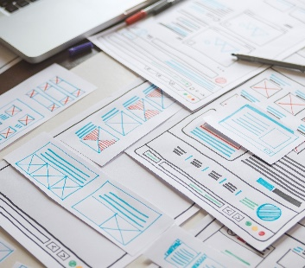
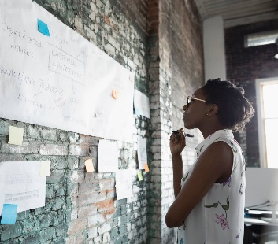
Thank you…
Customer Personality Analysis

